Slide 1
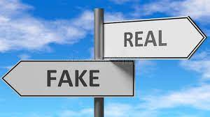
USE OF ARTIFICIAL NEURAL NETWORK TO IDENTIFY FAKE PROFILES
Group MembeRS
vuppu rama lova alekhya - 19mh1a0559
yerra harika - 19mh1a0560
thanari ramesh - 19mh1a0556
Under the guidance of
V.CHANDRA SEKHARA Rao M.Tech.,(Ph.D)
Associate Professor
Dept. of CSE

Slide 2
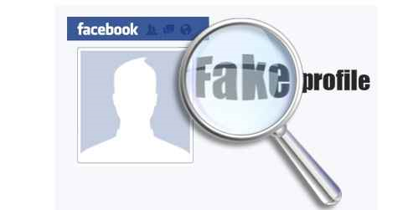
ABSTRACT
In this project, we use machine learning, namely an artificial neural network to determine what are the chances that Facebook friend request is authentic or not. We also outline the classes and libraries involved. Furthermore, we discuss the sigmoid function and how the weights are determined and used. Finally, we consider the parameters of the social network page which are utmost important in the provided solution.

Slide 3
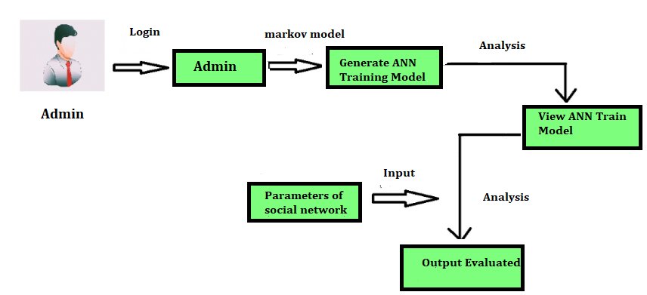
System Architecture

Slide 4
Thank you!

